Slide 1
just-training.eu
Time, tasks and teamwork management
Partner: University of Málaga

Slide 2
Learning outcomes
At the end of this module you will:
understand the importance of personal organization to improve productivity
understand the process of planning
learn how to avoid procrastination

Slide 3
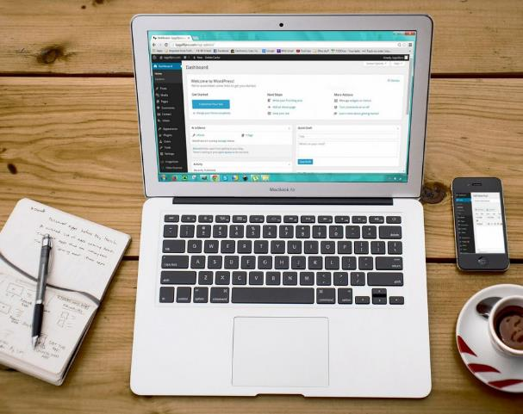
Index
Time and tasks management
Personal organization
Planning activities
Stop time thieves in meetings

Slide 4
Time and Tasks Management
Personal organization
Personal organisation is the action a person takes to structure his or her actions in a productive and psychologically balanced way. It includes a whole set of skills that allow the person to deal efficiently with his or her tasks.

Slide 5
Time and Tasks Management
Personal organization
It involves a set of abilities that can be acquired and improved.
[abilities]
[having or learning]
[improve]

Slide 6
Time and Tasks Management
Personal organization: Objectives
Personal organisation implies knowing the starting point before starting a task, what the objectives are, knowing the available resources, planning a procedure and establishing a timetable. Objectives should be SMART.
[Specific]
[Measurable]
[Achievable]
[Realistic]
[Time-bound]

Slide 7
Time and Tasks Management
Personal organization: SMART objectives let
[Increase productivity]
[Focus attention]
[Reduce distress]
[Avoid procrastination]

Slide 8
Time and Tasks Management
Personal organization: Objectives
When the objectives are very large, complex or very long-term, it is useful to split them into simpler and short-term objectives.
image: https://pixabay.com/photos/figure-puzzle-last-part-success-3277570/ Free to useunder pixaby license

Slide 9
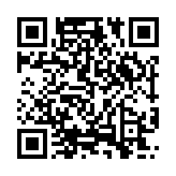
Time and Tasks Management
Planning activities
Personal planning is the ability to set personal goals, to have a plan of action and to carry them out, which helps to improve professional performance.
Classification tasks help to plan activities, prioritizing them and allowing to give enough time. A well-known method of classification is the urgent-important matrix. More strategies on https://www.usa.edu/blog/time-management-techniques/

Slide 10
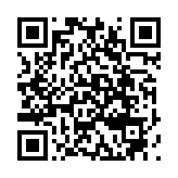
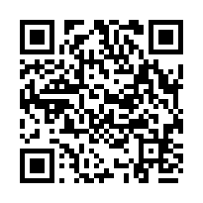
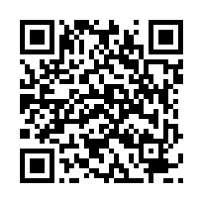
Time and Tasks Management
Planning activities
To know about the urgency-importance matrix and how to handle it, access these videos by scanning QRs or clicking the links. After, comment with partners or mates.
https://www.youtube.com/watch?v=nBy-3G1m-ME
https://www.youtube.com/watch?v=-xyYArJnEGE
https://www.youtube.com/watch?v=sD44_TGcyVQ

Slide 11
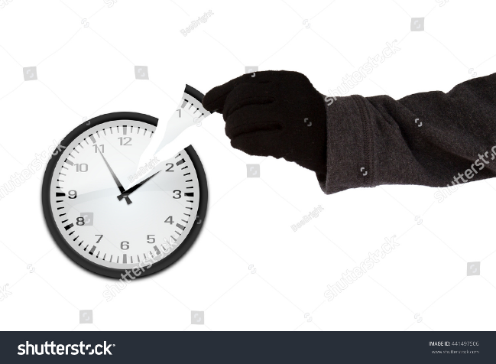
Teamwork more efficient
Stop time thieves in meetings: attitude and behavior to avoid them
What are time thieves?
In the world of work, they are those activities or people or even situations that make you waste your time. There are external and internal ones and you have to be the one who decides if they are going to steal your time or not.
There are two time thieves:
External
Internal

Slide 12
Teamwork more efficient
Stop time thieves in meetings: attitude and behavior to avoid them
External Time Thieves:
Interruptions
It is one of the most frequent time thieves. They can be: calls, visits without an appointment, requests for help...
When you are faced with an interruption, it is important that you remain firm and decide whether or not your time is stolen.

Slide 13
Teamwork more efficient
Stop time thieves in meetings: attitude and behavior to avoid them
If you receive one of these interruptions, assess whether it is an emergency that requires your immediate attention.
If you decide that it is not necessary to attend to him at that moment, decline the interruption, politely and firmly.
Put some barriers to avoid these interruptions, such as turning off the phone, closing the office door, using headphones, asking that you not be interrupted at certain times, etc.

Slide 14
Teamwork more efficient
Stop time thieves in meetings: attitude and behavior to avoid them
Notifications
The notifications are almost never urgent, for example:
Mail
Social networks
Instant messaging
Subscriptions
You must lose the fear of being disconnected from these channels for a few hours.
How to avoid :
Silence all notifications
Ignoring them is hard, so it's better not to have them.
Set the times of the day that you will check each channel.

Slide 15
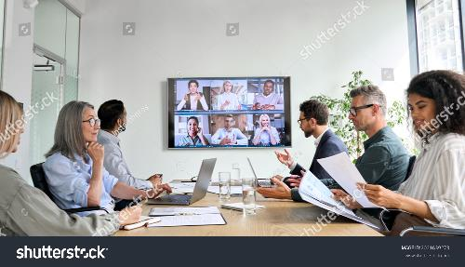
Teamwork more efficient
Stop time thieves in meetings: attitude and behavior to avoid them
Meetings
If you work with other people, you will necessarily have to attend meetings; also with clients, partners or suppliers. Meetings in themselves are not time-stealers, only when they are done badly, so that your meetings don't become time-stealers
Important aspects
The form: Meetings should have a structure, with a start and end time
Content: also the topics that are going to be discussed.
Urgencies: Most of them are not true emergencies, so it does not require immediate attention.

Slide 16
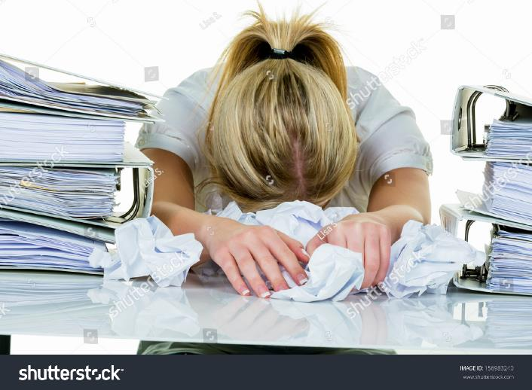
Teamwork more efficient
Stop time thieves in meetings: attitude and behavior to avoid them
Internal Time Thieves:
Lack of organization
The best thing to do is to dedicate some time each day to planning and monitoring activities.

Slide 17
Teamwork more efficient
Stop time thieves in meetings: attitude and behavior to avoid them
Internal Time Thieves:
Procrastinating
You know that these tasks are not going to go away; by postponing them you only manage to turn them into urgencies later on.

Slide 18
Time and Tasks Management
Managing procrastination
To know about the urgency-importance matrix and how to handle it, access these videos by scanning QRs or clicking the links. After, comment with partners or mates.Procrastination is spending too much time doing things we don't have to do, or that are unimportant, instead of spending time on the things that really matter.
There are also multiple negative effects: job performance, reputation, anxiety, self-steem, health problems, etc.
Image: https://pixabay.com/illustrations/postpone-postponed-delay-delayed-4951898/Free to useunder pixaby license

Slide 19
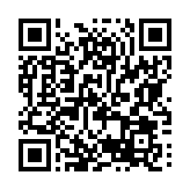
Time and Tasks Management
Managing procrastination
[Avoid multitask]
[Avoid distractions]
[Focus attention]
[“I choose” instead of “I have”]
https://www.mindtools.com/a5plzk8/how-to-stop-procrastinating

Slide 20
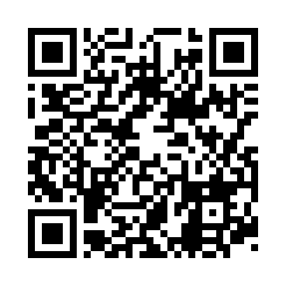
Time and Tasks Management
Managing procrastination
What is Pomodore technique? Watch this video.
https://www.youtube.com/watch?v=mNBmG24djoY

Slide 21
Teamwork more efficient
Stop time thieves in meetings: attitude and behavior to avoid them
Internal Time Thieves:
Not delegating and not knowing how to say "no“
These two behaviors rob you of a lot of time and energy. When you don't delegate some of your tasks and pretend to do everything, you overload yourself and run out of time for the tasks that are really important
Communication problems
In your personal life and in your work, interaction with other people is very frequent. In order for these interactions not to become time-stealers that slow down your productivity, you need to train your communication skills.

Slide 22
Summing up
Personal organization improves:
Planning
Classify - Eisenhower matrix
Assign times.
The productivity and
Emotional stability.
Procrastination
Define SMART goals
Pomodore technique
Stop time thieves
Break down complex goals
External and internal

Slide 23
just-training.eu
Thank you!

